Slide 1

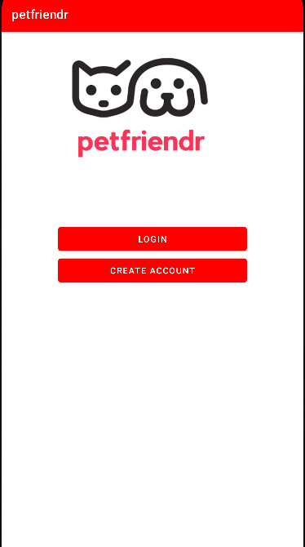
Petfriendr
Amy Moretti
Zoe Riederman
Joe Salemi
Jessica Solis

Slide 2
Project Overview
Motivations
Target Audience
Notes:
Zoe - Overview of what the app is, the motivations behind creation, and the target audience

Slide 3
Introduction - Motivation
Social media platforms have amassed over 5 billion users worldwide since their introduction in the 1980s. Mobile application development has exploded as society becomes ever more dependent upon mobile technologies such as smartphones and tablets. Now, users have access to applications like Instagram, Facebook, and Twitter at their fingertips at any time of day. Thus, one would think it has never been easier to stay in touch with friends and family, share thoughts, photos, and videos, or kill time with mindless scrolling. However, social media platforms seem to be drifting away from their original intent, to connect people, to being used for other reasons. Lately, social media seems to be a significant source of frustration, anxiety, and fear instead. While it seems there is an app for everything - productivity, fitness, cooking, dating - there isn't an app out there to connect and develop friendships with people who have pets or people who simply love pets. Insert Petfriendr. Petfriendr is an Android application created to bring the focus back to connecting like-minded people with others interested in the same things - in our case, pets. We have eliminated time wasted sifting and searching through Instagram or Facebook groups for cat lovers, for instance, to connect all pet lovers. Our app is for any user that wants to post their new cute corgi puppy, escape anxiety-inducing news feeds on Twitter, or mindlessly scroll and comment on cute cat photos.
Notes:
Use this for additional slides

Slide 4
Introduction - Target Audience
Pet owners and pet lovers who wish to connect with other pet owners and pet lovers, in order to make more pet and pet owner friends.
Social media addicts looking for something more wholesome to scroll through.
Notes:
Use this for additional slides

Slide 5
Intended Functional Requirements
The user must be able to log in or sign up.
The user must be able to reset their password if ever forgotten.
The user must be able to update his/her personal information.
The user must be able to add pet information to his/her profile including photos, name, and a brie biography.
The user must be able to receive and respond to messages.
The user must be able to swipe left/right.
Enable/disable push notifications.
The system must store data in a secure database.
The user must be able to enable/disable access to their camera.
The user must be able to enable/disable access to their location.
The user must be able to contact user support.
Notes:
Use this for additional slides

Slide 6
Application Features
User Account Sign-Up
Accounts stored in Firebase.
Passwords hashed and stored securely.
User Account Login
Ability to Edit Profile
Profile details including image stored in Firebase.
Ability to view a feed of other profiles
Profiles are displayed in a small card with each profile populating within the scroll view.
Ability to select a profile for more detailed view
Ability to comment on said profile in this profile view
Comments stored in Firebase.
Notes:
Use this for additional slides

Slide 7
Missed Features
Swiping functionality
This was to be the primary method of navigation through user profiles, however this was a significant hurdle that we scrapped in favor of displaying a static feed of all users, more similar to how one might see an Instagram feed as opposed to swiping through profiles like one does on apps like Tinder. The initial code written for this can be found in the /phase3RejectedCode folder at the top level of this project.
Location Features
Google Maps was implemented however once the primary features of this application were determined, it no longer made sense to include. The code for this is also located in /phase3RejectedCode. The end goal was to still implement this and allow users to see each other's locations, but unfortunately we ran out of time.
Profiles Searchable
Unfortunately there was not enough time to implement any type of profile search.
Notes:
Use this for additional slides

Slide 8
Use Cases
Notes:
Zoe

Slide 9
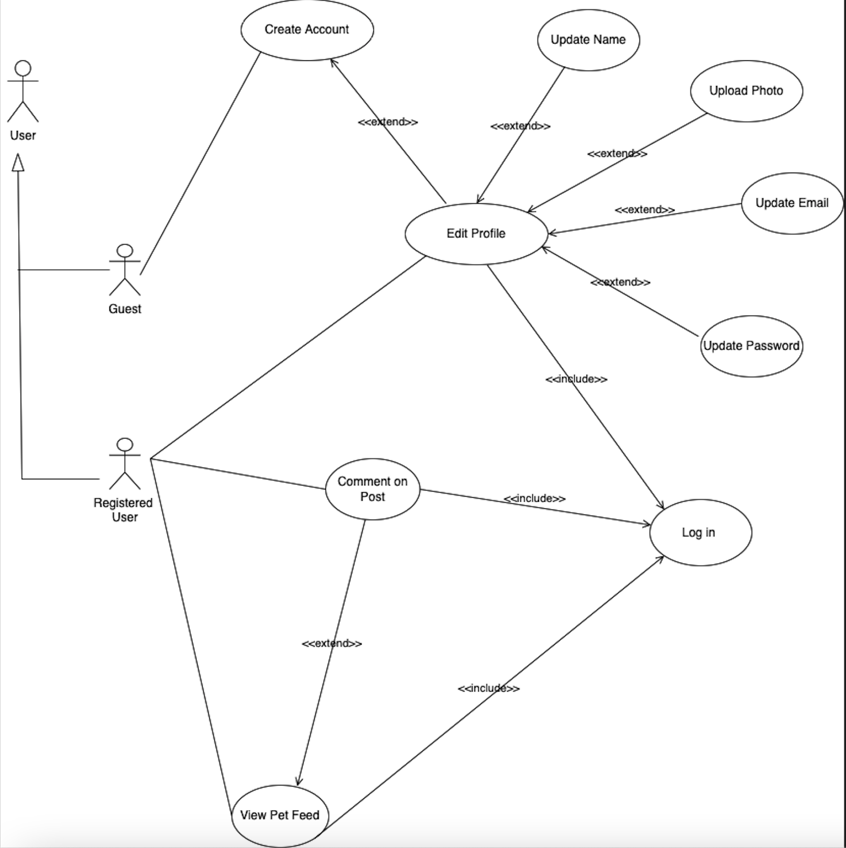
Use Case Diagram
Notes:
Use this for additional slides

Slide 10
User Sign-Up
Actor: Unregistered user who wishes to make an account. I.e., Guest
Description: An unregistered user will be able to create an account by providing a few pieces of information.
Pre-Condition: User does not have login credentials Post-Condition: Guest will become a registered user and will now have access to the features of the app..
Flow of Events:
User launch the app and be brought to the MainActivity page.
User will be asked to allow access to their location.
Note: We did not do anything further with this feature but we did implement location services. However, given more time we would have implemented the ability for the user to turn off location access which is something the user cannot do today.
User will click on “create account.”
User will be brought to the create account page where he/she will enter the required information: username, email address, and password
User will click ‘create account’ button..
User will be taken to the main activity page,login, and be taken to view pet profiles.
Alternative Flow: None
Notes:
Amy

Slide 11
User Login
Flow of Events:
System asks the user for a username and password. If none, the user should go back and click on create account instead.
User will enter their username, email address in this case, and password.
System validates the username and password.
User will log in.
User will head to view/scroll through pet profiles and leave comments.
User can navigate to their the edit profile activity to update their photo, email, and password.
Alternative Flow:
1. User enters incorrect username and/or password.
2. System displays the error message.
a. User re-enters username and/or password.
b. User logs in.
Actor: Registered user.
Description: The user will successfully log into petfriendr to have access to all of the app’s features.
Pre-Condition: User has login credentials Post-Condition: Registered users will have access to their account information and will be able to change their personal information, update pet information, etc.
Notes:
Amy

Slide 12
View User Profiles
Actor: A registered user
Description: All registered users will have access to a profile feed where they will be able to view other user’s pet photos and comment if wanted.
Pre-Condition: User has an active account.
Flow of Events:
User logs in.
The user is taken to the pet profiles other registered users’ profiles.
The can leave a comment.
Alternative Flow: None
Notes:
Amy

Slide 13
User Edit Profile
Actor: Registered user or a new user
Pre-Condition: Users have an existing petfriendr account or create an account. Post-Condition: Users will have updated their personal information.
Flow of Events:
Users log in.
User is taken to the list of pet profiles..
User uses the navigation bar at the bottom to navigate to the edit profile activity.
User makes necessary updates and clicks on ‘update profile’ button.
Alternative Flow:
New user creates an account
User is taken directly to the edit profile page
User makes changes.
User clicks on ‘update profile’ button.
Notes:
Amy

Slide 14
Test Cases
Notes:
Jessica - Test Cases

Slide 15
Testing Results
Results: To test our android application, we performed several manual tests, and leveraged Android’s Espresso UI testing tool to ensure all UI interactions were successful and if not where we needed to apply a fix. .
Espresso UI Test Recorder results were all successful for the login and sign-up functionalities.
The rest of the features were tested manually.
Link to manual tests here: https://docs.google.com/spreadsheets/d/14RB1EiR8REHAGis-Hol-il7hZtgYnIsnsLTwjK8Pm5c/edit?usp=sharing
Notes:
Use this for additional slides

Slide 16
PetFriendr Demo
Notes:
Joe - demo features

Slide 17
Conclusion
Notes:
Amy

Slide 18
References
Mc Mahon, C. (2015). Why do we ‘like’ social media? The Psychologist, 28(9), 724-729.
https://www.entrepreneur.com/article/293454
https://online.maryville.edu/blog/evolution-social-media/
https://wersm.com/the-10-top-reasons-why-we-use-social-networks/#:~:text=What%20Are%20The%20Top%2010%20Reasons%20For%20Using,%2837%25%29%205%20General%20networking%20with%20other%20people%20%2834%25%29

